Slide 1
Rock Art

Slide 2
Art Assignment:
View the photographs in this Powerpoint
Collect small items from nature or your home (rocks, leaves, marbles, Legos, etc)
Sort items by size, color or texture
Draw and label your sorted objects
Create an “Installation” with your objects. This is like a sculpture but does not have to necessarily last. You might try a few solutions such as arranging objects in a spiral, creating an animal, spelling a word out, stacking objects, etc. What looks interesting and beautiful to you?
Draw or photograph your installation.
Option to upload a photograph of your art to your Art Class Seesaw portfolio

Slide 3
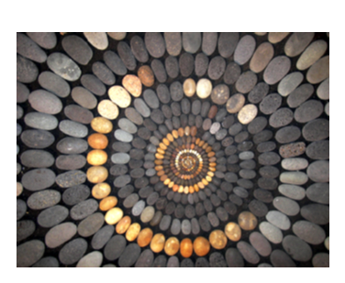
Artist: Mary Bauermeister
How would you sort your rocks/marbles/legos to create this installation? Try grouping by size, color and texture (smooth, rough). Before you create an art piece out of found objects, try sorting first.

Slide 4
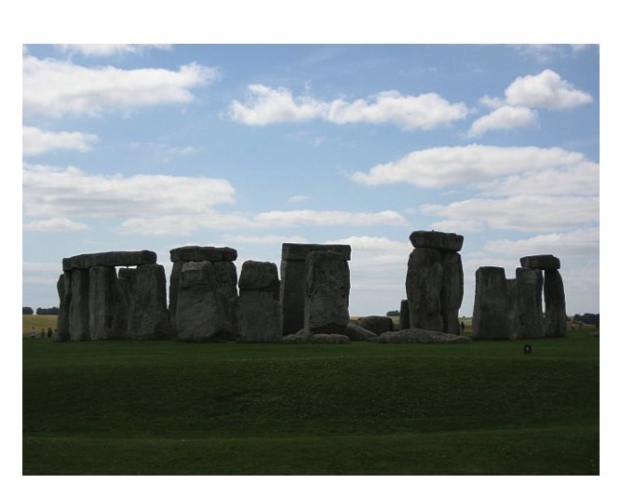
Stonehenge (Wiltshire, England)
This is a very old monument. We wonder how it was created thousands of years ago without modern machines. Look at the people standing near it to understand the size of these stones. This must have been a very special place long ago.

Slide 5
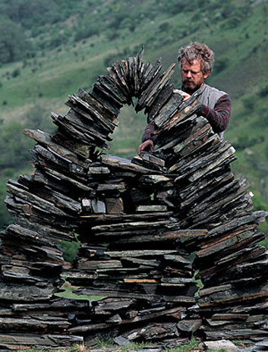
Andy Goldsworthy is a nature & installation artist. His work is often ephemeral (lasting a short time) so when his work falls, melts or changes with the weather and environment that is part of the art. Photographs and video help document his work. He practices perseverance to get pieces to fit together as it takes much problem solving.

Slide 6
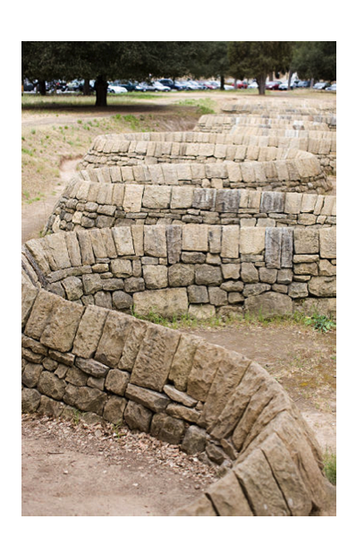
Stone River by Andy Goldsworthy, Stanford University

Slide 7
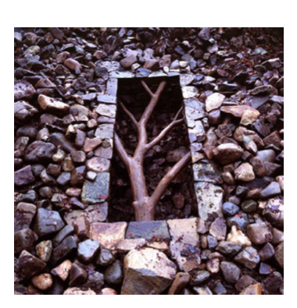

Slide 8
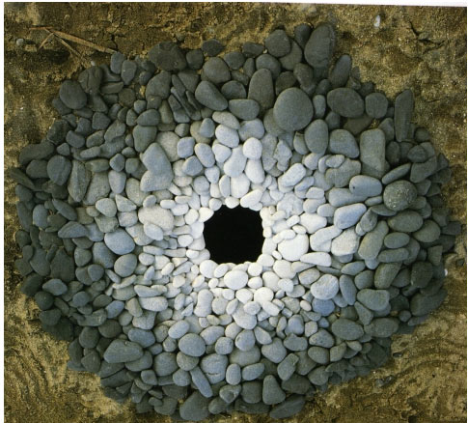

Slide 9
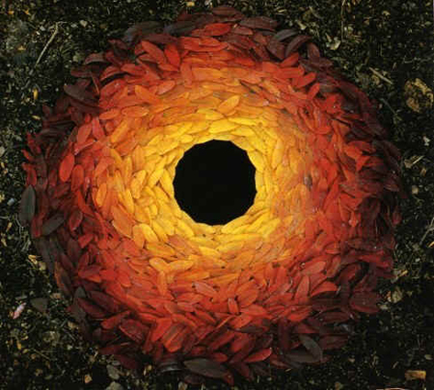

Slide 10
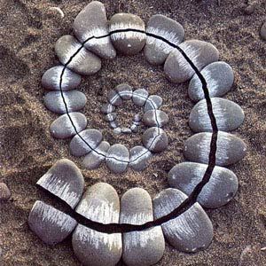

Slide 11
Art Assignment:
View the photographs in this Powerpoint
Collect small items from nature or your home (rocks, leaves, marbles, Legos, etc)
Sort items by size, color or texture
Draw and label your sorted objects
Create an “Installation” with your objects. This is like a sculpture but does not have to necessarily last. You might try a few solutions such as arranging objects in a spiral, creating an animal, spelling a word out, stacking objects, etc. What looks interesting and beautiful to you?
Draw or photograph your installation.
Option to upload a photograph of your art to your Art Class Seesaw portfolio (to view work other kids have created look here

