Slide 1
ATC (Artist Trading Card) – goal to make 3-5 or more
2.5” x 3.5”
Any 2D medium, design both sides
Sign & Date card
Photograph your set on Seesaw
Trade with other artists! (Please wait to trade until later in 2020)
Note: This was assigned to all Encinal 3rd-5th graders February 2020. Students may continue making cards and posting their work to their Art Class Seesaw portfolio.

Slide 2
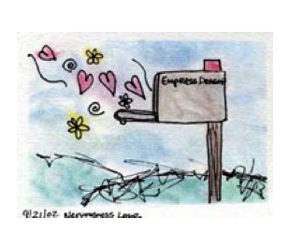

Slide 4
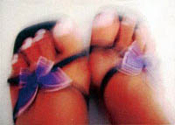

Slide 5
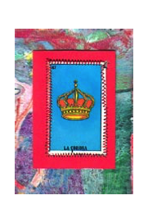
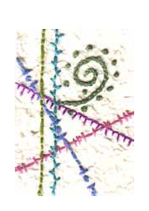

Slide 6
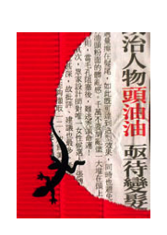
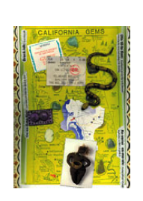
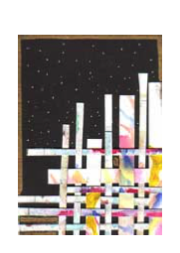

Slide 7
Medium ideas for ATC:
*Watercolor (consider doing “wet mediums” first)
*Flair black pens (not permanent) – good for details, zentangle, drawing, etc
*Collage (construction paper, newspapers, magazines, old calendars)
*Paper weaving
*Colored pencils
*Any combination of 2D materials
(stencils, crayons, crayon rubbings, colored pencils, collage with fabric/ribbon, etc)

Slide 8
About ATCs (Wikipedia):
Artist trading cards (ATCs) is a conceptual art project initiated by the Swiss artist M. Vänçi Stirnemann in 1997. He called it a Collaborative Cultural Performance. Artist trading cards are 2 1⁄2 by 3 1⁄2 inches (64 mm × 89 mm) in size, the same format as modern trading cards (hockey cards or baseball cards). They are self-made unique works or small series, signed and dated on the reverse by the artist/producer, exchanged and collected by the people who participate in the collaborative performance.

